Slide 1

Dealing with Concurrency / Multi-Threading in .NET
Halil İbrahim Kalkan
https://github.com/hikalkan/presentations

Slide 2

What is Multi-Threading?
Executing different parts of your application code simultaneously.

Slide 3
Why Multi-Threading?
Utilizing power of multi-core processors by parallelizing CPU-bound tasks.
Responding multiple clients concurrently.
Running long tasks in background to increase responsiveness.

Slide 4
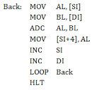
Single Core / Process Execution
SOURCE CODE
P R O C E S S
EXECUTE
S₁
S₈
S₇
S₆
S₅
S₄
S₃
S₂
S₁
S₂
S₃
S₄
CPU
S₅
S₆
S₇
S₈

Slide 5
Single-Core / Single-Processing
P R O C E S S A
P R O C E S S B
S₈
S₇
S₆
S₅
S₄
S₃
S₂
S₁
S₈
S₇
S₆
S₅
S₄
S₃
S₂
S₁
Execute
Execute
S₈
S₇
S₆
S₅
S₄
S₃
S₂
S₁
S₈
S₇
S₆
S₅
S₄
S₃
S₂
S₁
CPU

Slide 6
Single-Core / Multi-Processing
P R O C E S S A
P R O C E S S B
S₈
S₇
S₆
S₅
S₄
S₃
S₂
S₁
S₈
S₇
S₆
S₅
S₄
S₃
S₂
S₁
Execute
Execute
S₈
S₇
S₈
S₇
S₆
S₆
S₅
S₄
S₅
S₃
S₄
S₃
S₂
S₂
S₁
S₁
CPU

Slide 7
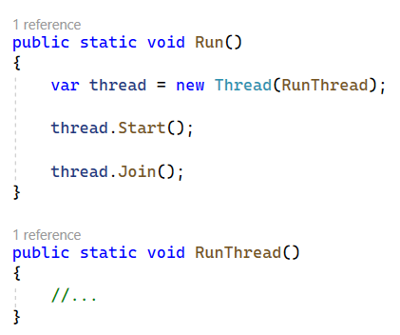
Thread: Start / Join
DEMO

Slide 8
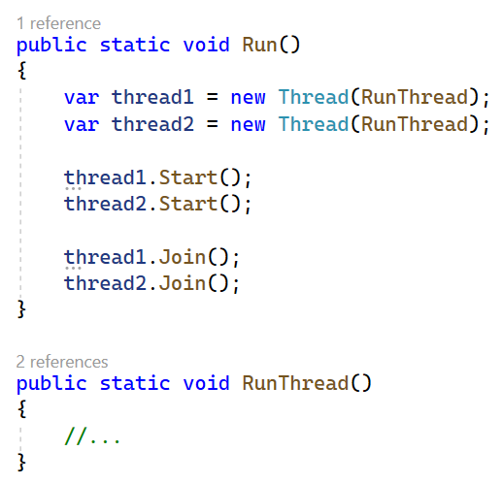
Multiple Thread: Start / Join
DEMO

Slide 9
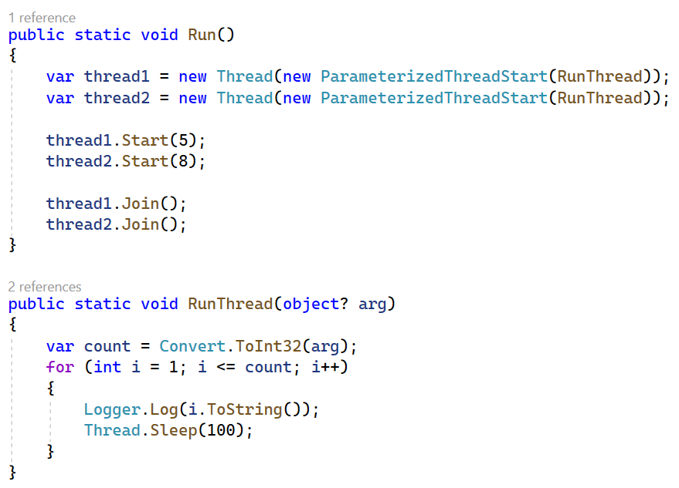
Parameterized Thread: Start / Join
DEMO

Slide 10
Sharing State Between Threads
All threads in a process share the same application state.
Should care while accessing a shared state/variable/field.
Can use exclusive locks to regulate concurrent access
DEMO

Slide 11
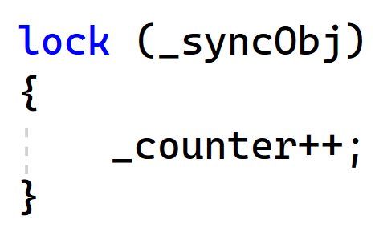
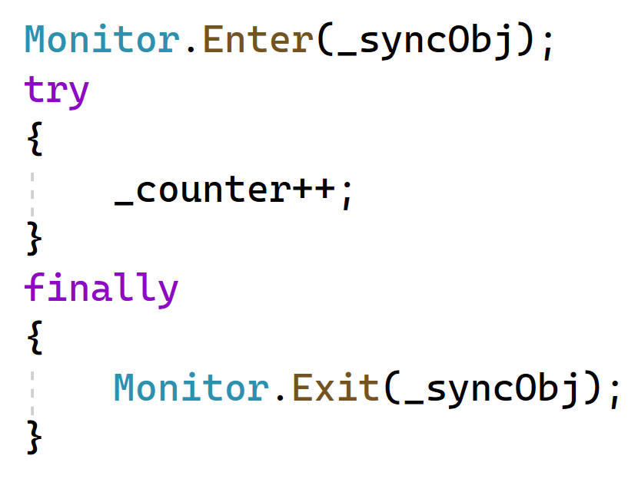
The Monitor Class
Monitor.Enter() / Monitor.TryEnter()
Monitor.Exit()
Monitor.Wait()
Monitor.Pulse() / Monitor.PulseAll()
DEMO

Slide 12
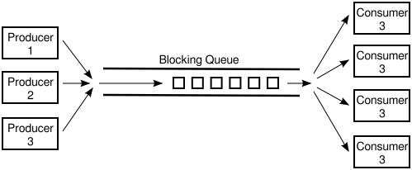
Producer-Consumer Pattern
One or multiple producer threads add work items to a queue
One or multiple consumer threads process work items and removes from the queue
Queue is exclusively accessed by all threads.

Slide 13
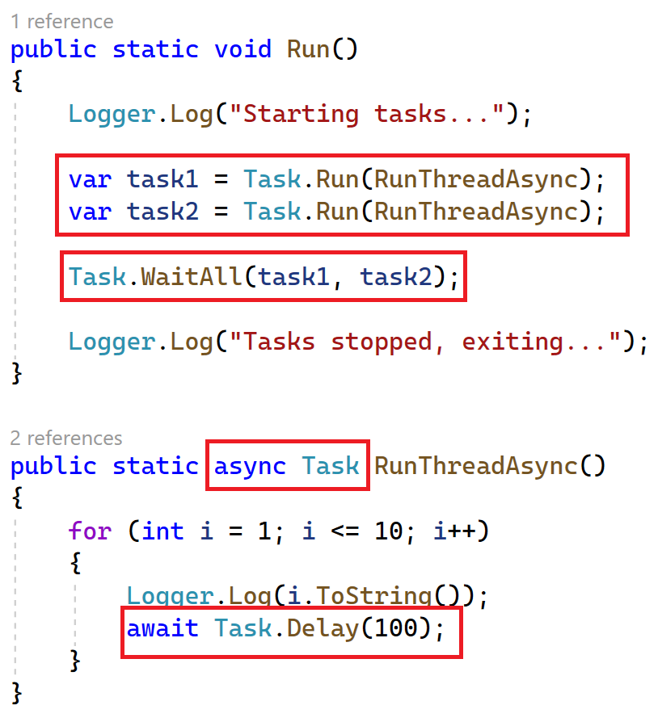
The Task Class & Async Execution

Slide 14
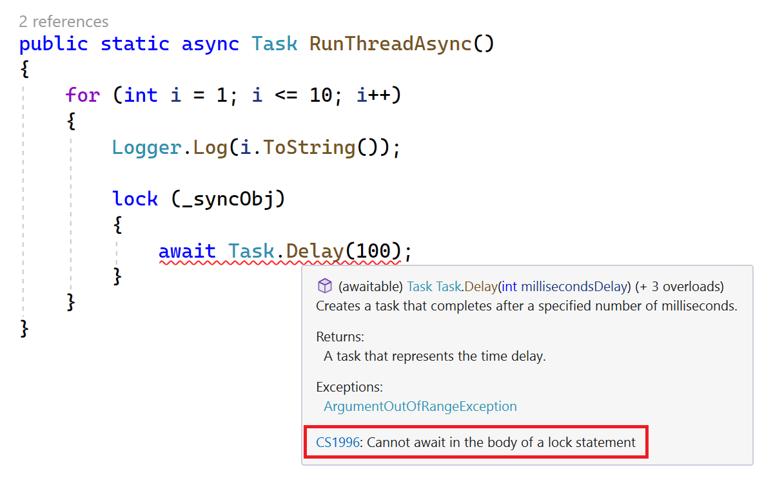
Locking vs Async Execution

Slide 15
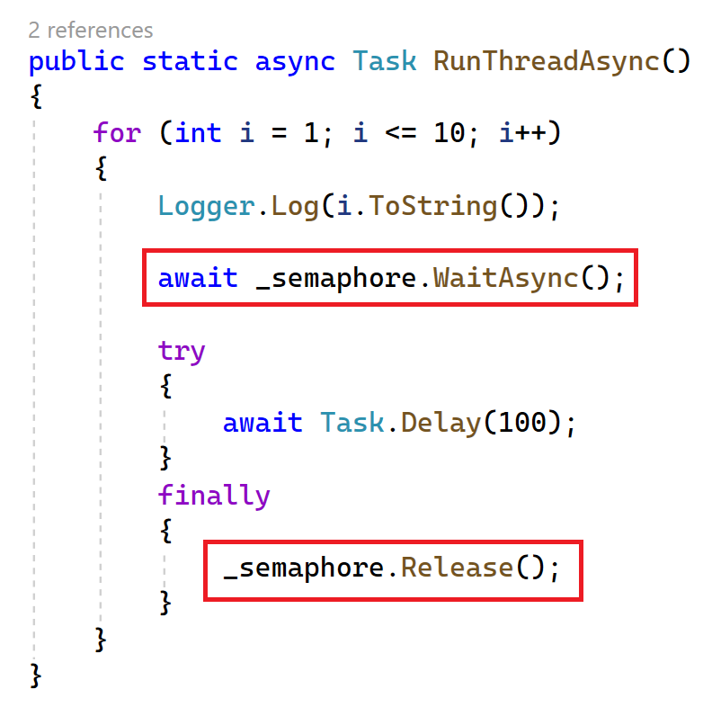
Semaphore / SemaphoreSlim

Slide 16
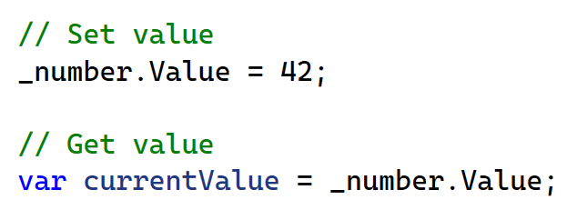
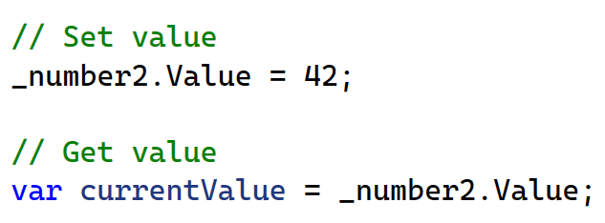
ThreadLocal & AsyncLocal

Slide 17


Mutex
Local (unnamed) mutexes: Thread synchronization
Named system mutexes: Process synchronization

Slide 18
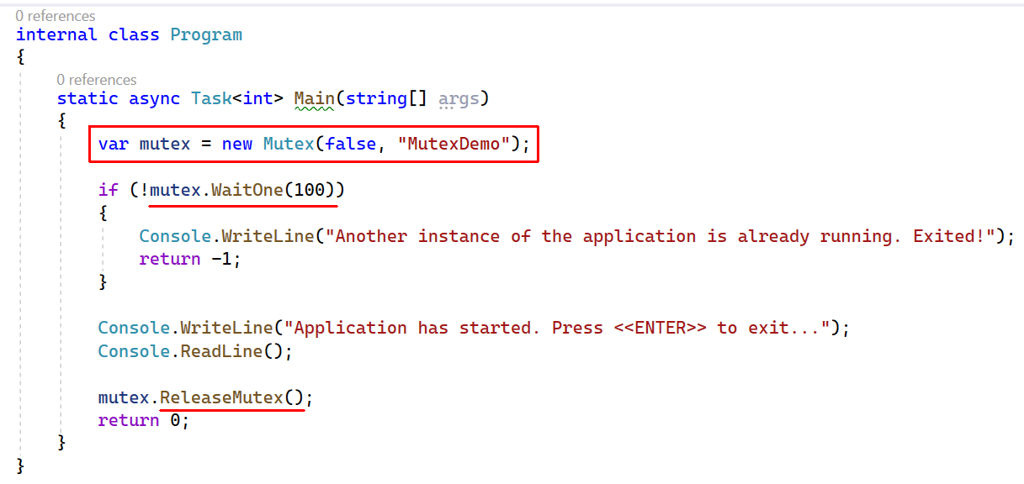
Mutex: Interprocess Locking

Slide 19
Topic title
Content

Slide 20
Topic title
Content

Slide 21
Topic title
Content

Slide 22
Topic title
Content

Slide 23
Topic title
Content

Slide 24
Topic title
Content

Slide 25
Thanks!
Get This Presentation
https://github.com/hikalkan/presentations
Contact Me
Home: https://halilibrahimkalkan.com
GitHub: @hikalkan | Twitter: @hibrahimkalkan
References
TODO

Slide 26
Topic title
Content

